Slide 1

LOTTERY SOFTWARE
SOLUTIONS
for true believers

Slide 2
The Power of a Platform

Slide 3
1
Go native.

Slide 4
2
Start with a blank
screen.

Slide 5
3
Configuration trumps
customization.

Slide 6
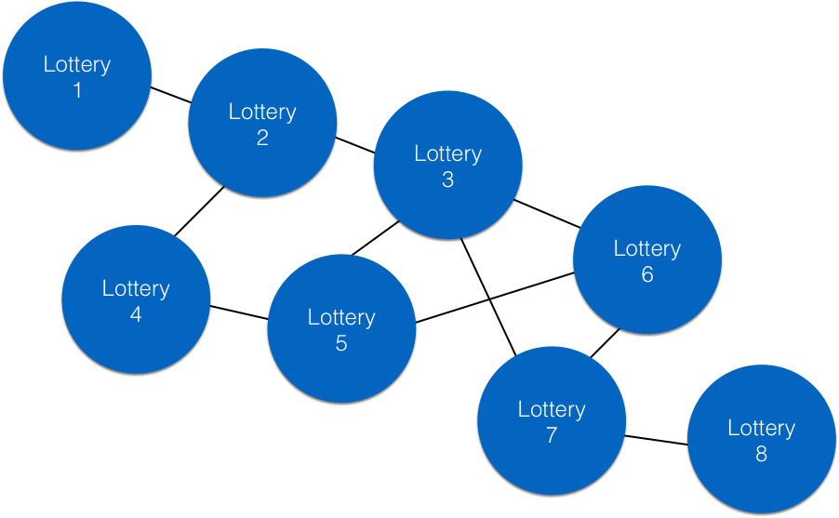

Slide 7
100%
Features immediately
available to all lotteries.

Slide 8
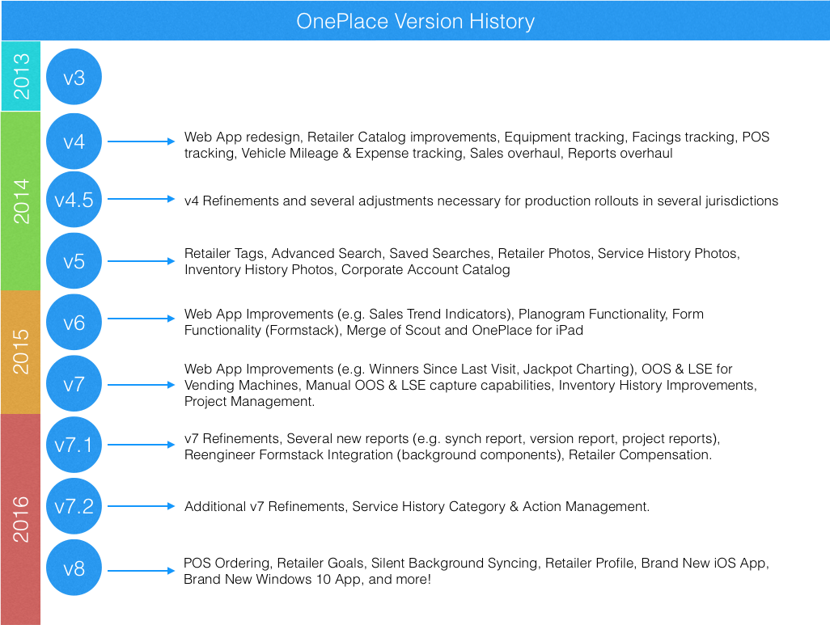

Slide 9
OnePlace 8
Silent Background Syncing
Brand new iPad app
Brand new Windows 10 app

